Slide 1

Doubly-Linked Lists
© 2013 Goodrich, Tamassia, Goldwasser
Doubly-Linked Lists
Notes:
Sequences

Slide 2




Doubly Linked List
A doubly linked list provides a natural implementation of the Node List ADT
Nodes implement Position and store:
  element
  link to the previous node
  link to the next node
Special trailer and header nodes
prev
next
elem
node
header
nodes/positions
trailer
elements
© 2013 Goodrich, Tamassia, Goldwasser
Doubly-Linked Lists
Notes:
Sequences

Slide 3
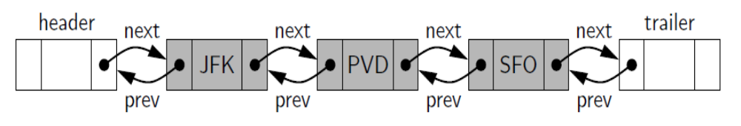
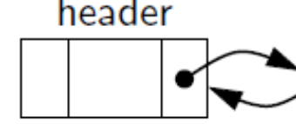
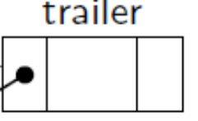
Header and Trailer Sentinels
When Empty:
© 2013 Goodrich, Tamassia, Goldwasser
Doubly-Linked Lists
Notes:
Sequences

Slide 4
Node Class for Double Link List
class _Node:
”””Lightweight, nonpublic class for storing a doubly linked node.”””
__slots__= _element , _prev , _next # streamline memory
def __init__(self, element, prev, next): # initialize node’s fields
self._element = element # user’s element
self._prev = prev # previous node reference
self._next = next # next node reference
© 2013 Goodrich, Tamassia, Goldwasser
Doubly-Linked Lists

Slide 5
Insertion
Insert a new node, q, between p and its successor.
p
A
B
C
p
A
B
q
C
X
p
q
A
B
X
C
© 2013 Goodrich, Tamassia, Goldwasser
Doubly-Linked Lists

Slide 6
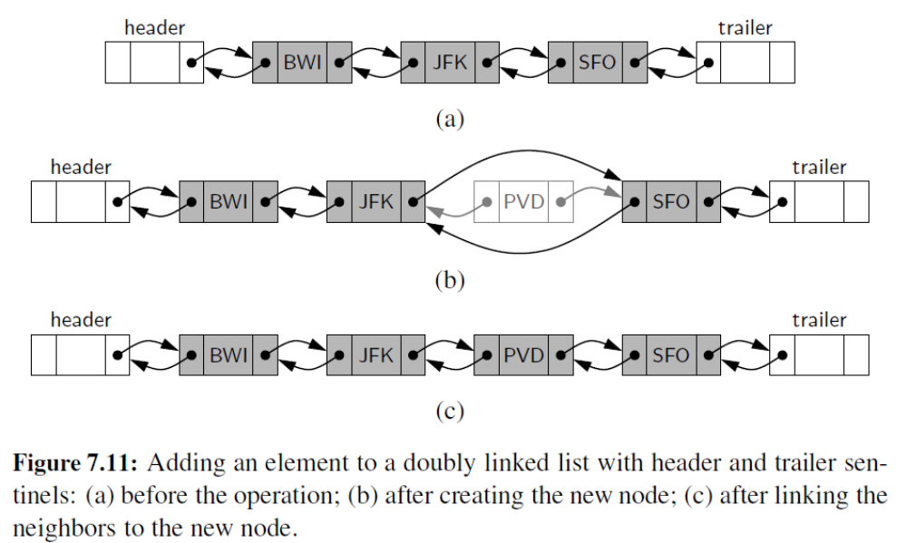

More Insertations Examples
© 2013 Goodrich, Tamassia, Goldwasser
Doubly-Linked Lists

Slide 7
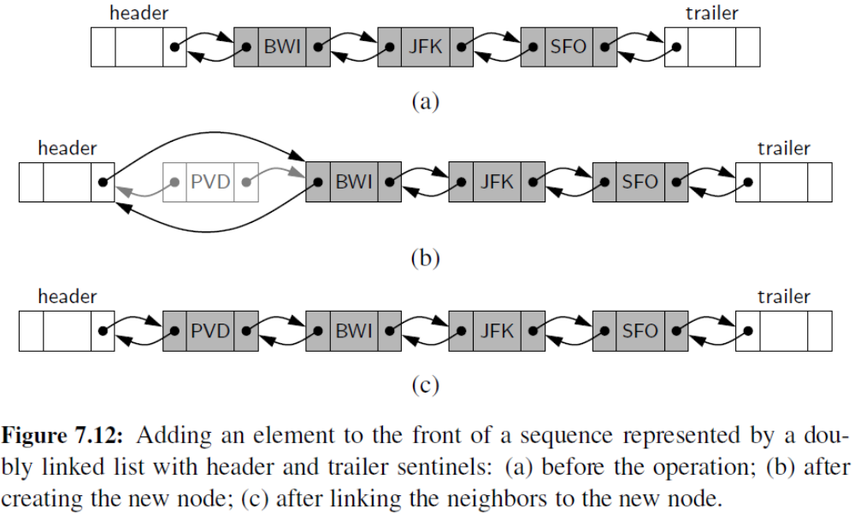
More Insertations
© 2013 Goodrich, Tamassia, Goldwasser
Doubly-Linked Lists

Slide 8
Deletion
Remove a node, p, from a doubly-linked list.
p
A
B
C
D
A
B
C
p
D
A
B
C
© 2013 Goodrich, Tamassia, Goldwasser
Doubly-Linked Lists

Slide 9
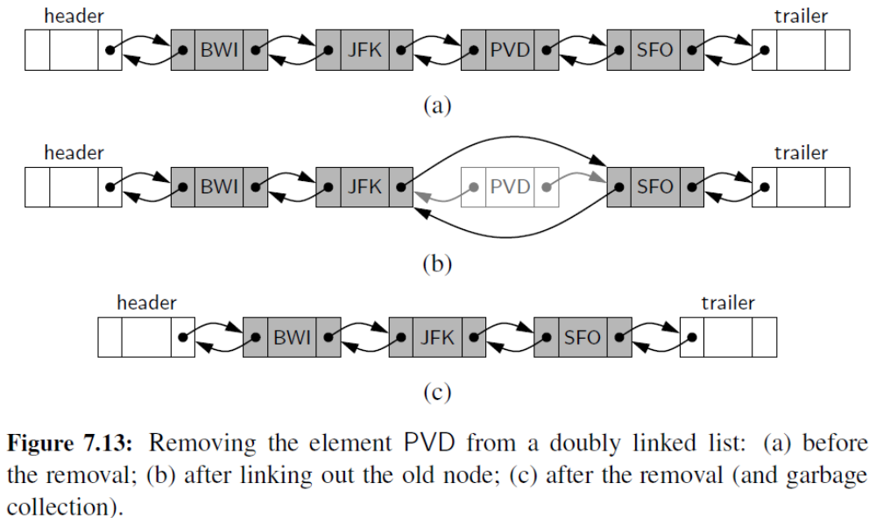
More Deletions
© 2013 Goodrich, Tamassia, Goldwasser
Doubly-Linked Lists

Slide 10
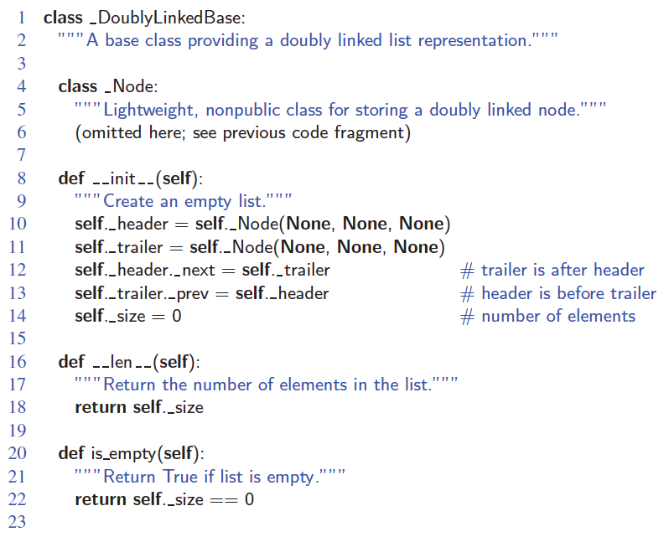
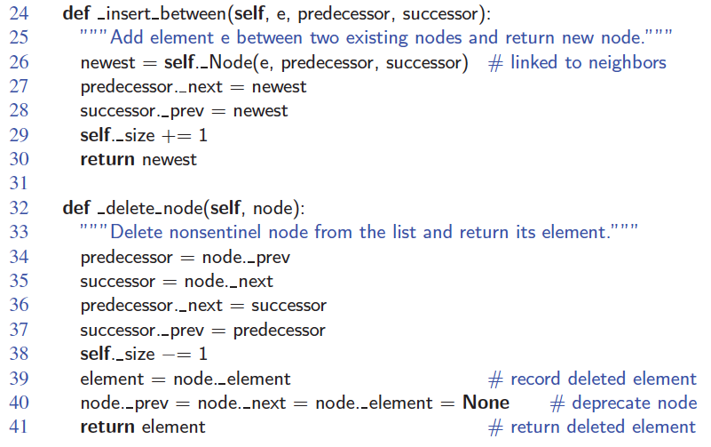
Doubly-Linked List in Python
© 2013 Goodrich, Tamassia, Goldwasser
Doubly-Linked Lists

Slide 11
Performance
In a doubly linked list
  The space used by a list with n elements is O(n)
  The space used by each position of the list is O(1)
  All the standard operations of a list run in O(1) time
© 2013 Goodrich, Tamassia, Goldwasser
Doubly-Linked Lists

Slide 12
Positional List
To provide for a general abstraction of a sequence of elements with the ability to identify the location of an element, we define a positional list ADT.
A position acts as a marker or token within the broader positional list.
A position p is unaffected by changes elsewhere in a list; the only way in which a position becomes invalid is if an explicit command is issued to delete it.
A position instance is a simple object, supporting only the following method:
  p.element( ): Return the element stored at position p.
© 2013 Goodrich, Tamassia, Goldwasser
Doubly-Linked Lists

Slide 13
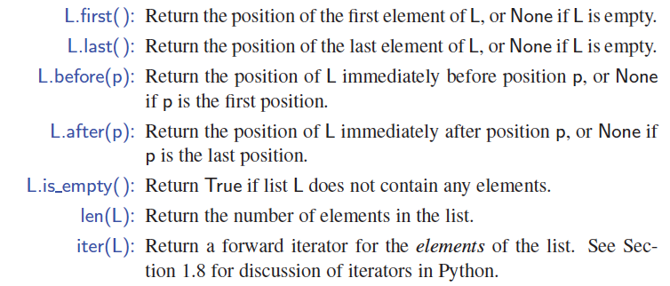
Positional Accessor Operations
© 2013 Goodrich, Tamassia, Goldwasser
Doubly-Linked Lists
Notes:
Sequences

Slide 14
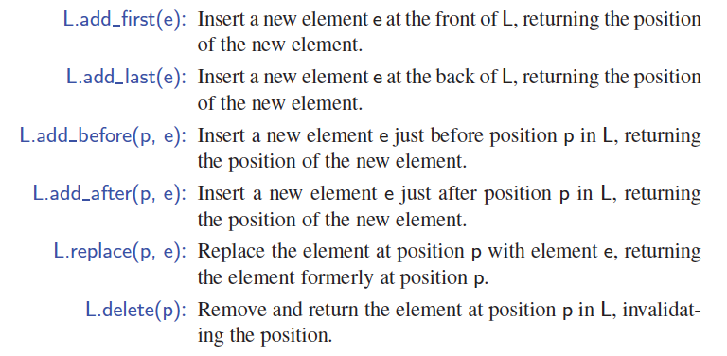
Positional Update Operations
© 2013 Goodrich, Tamassia, Goldwasser
Doubly-Linked Lists

Slide 15
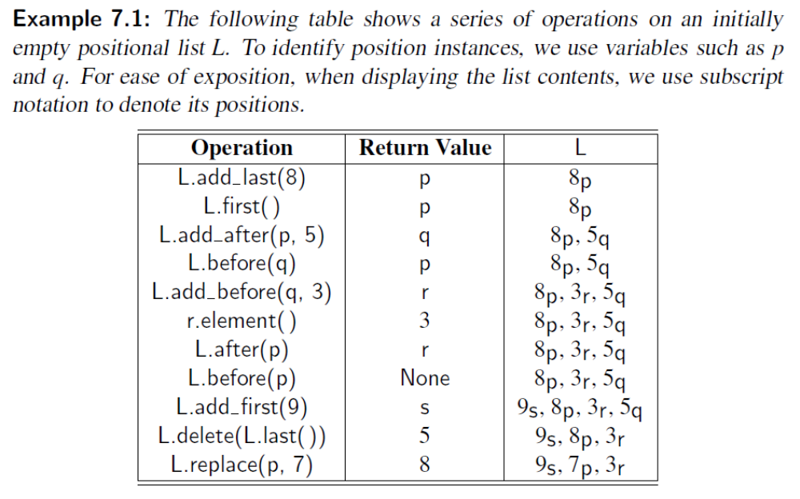
Usage of Positional Lists
© 2013 Goodrich, Tamassia, Goldwasser
Doubly-Linked Lists

Slide 16
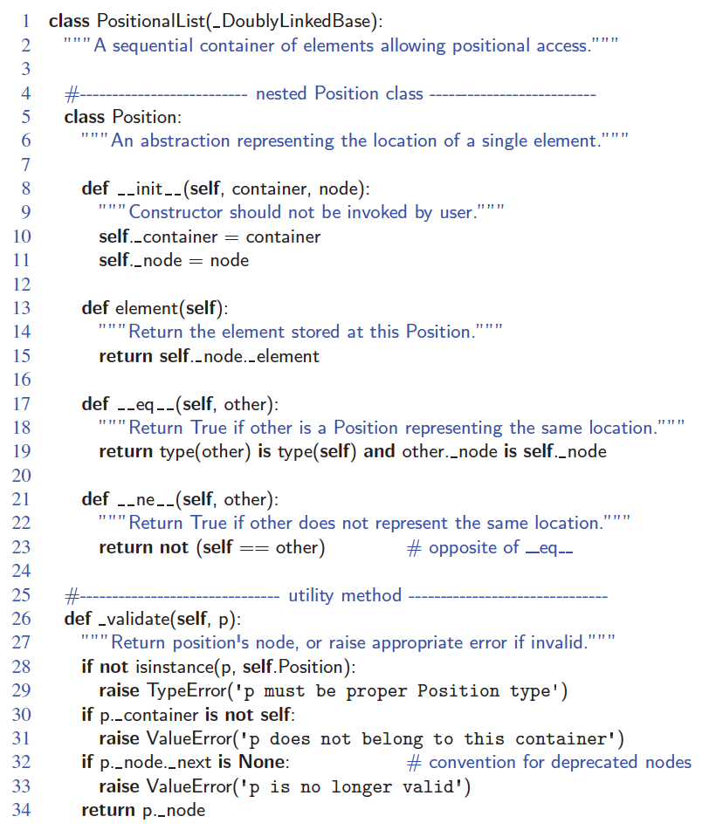
Positional List in Python
© 2013 Goodrich, Tamassia, Goldwasser
Doubly-Linked Lists
Notes:
Sequences

Slide 17
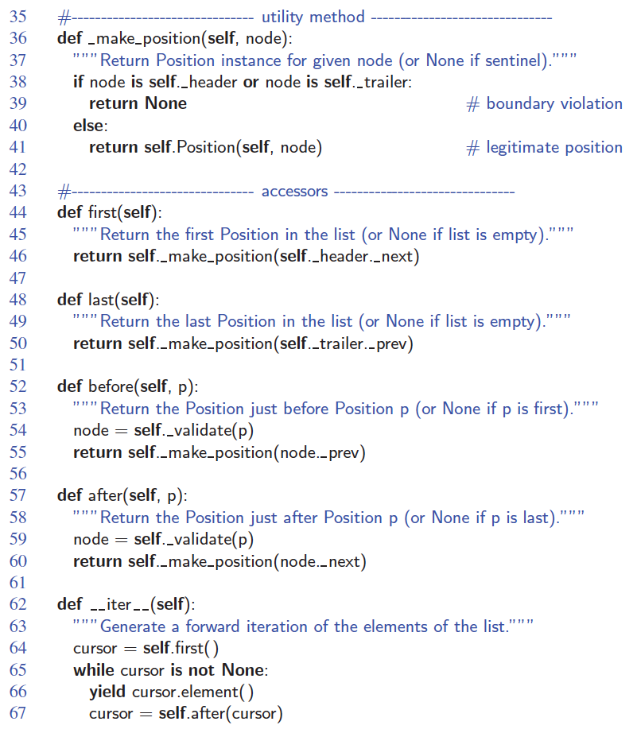
Positional List in Python, Part 2
© 2013 Goodrich, Tamassia, Goldwasser
Doubly-Linked Lists

Slide 18
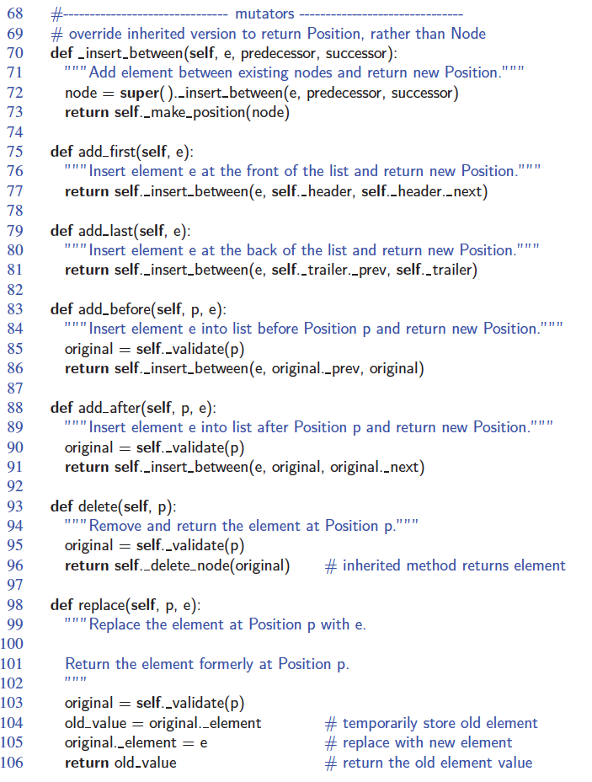
Positional List in Python, Part 3
© 2013 Goodrich, Tamassia, Goldwasser
Doubly-Linked Lists

